Slide 1

Atal Bihari Vajpayee-
Indian Institute of Information Technology and Management Gwalior
Computer Graphics Lab : 03
Line Drawing Algorithms
Instructor – Dr. Sunil Kumar
Assistant Professor @ Dept. of Information Technology, ABV-IIITM Gwalior
Teaching Assistants (TAs)
Mehr Aliah, Sheel Patel, Pranav | Group-02
Anushka Agarwal, Abhishek Shrivastav, Radhika Gupta, Aditya | Group-01

Slide 2
Objective of this lab
The objective of this lab is to draw line segments and graphics on a computer screen using equations of straight lines, while understanding and minimizing the floating-point operations (FLOPs) required for line generation. The lab involves using different forms of the line equation, such as y=mx+c and x=my​−mc​, for drawing lines between given endpoints.

Slide 3
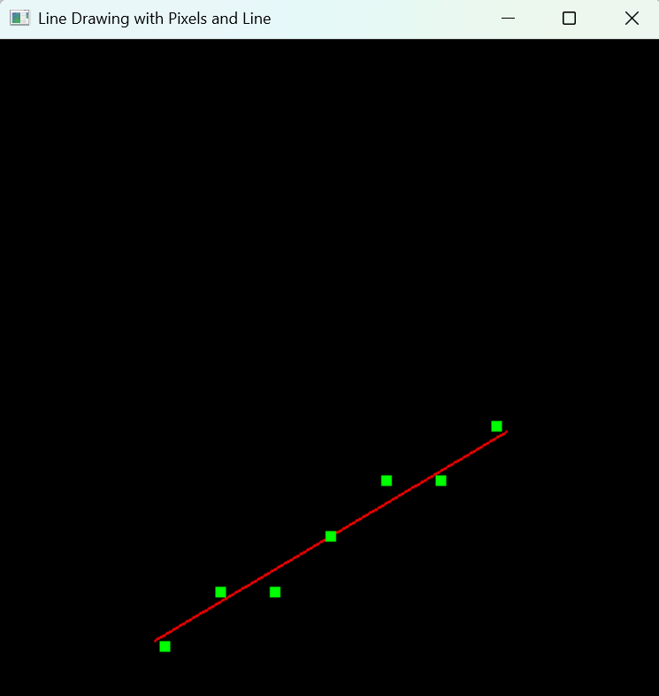
Demo Assignment - 01
#include <GL/glut.h>
#include <cmath>
void display() {
glClear(GL_COLOR_BUFFER_BIT);
float x1 = 2.8f, y1 = 1.1f;
float x2 = 9.2f, y2 = 4.9f;
glColor3f(1.0f, 0.0f, 0.0f);
glLineWidth(2.0f);
glBegin(GL_LINES);
glVertex2f(x1, y1);
glVertex2f(x2, y2);
glEnd();
float m = (y2 - y1) / (x2 - x1);
float c = y1 - m * x1;
glColor3f(0.0f, 1.0f, 0.0f);
glPointSize(8.0f);
glBegin(GL_POINTS);
for (int x = (int)round(x1); x <= (int)round(x2); x++) {
float y = m * x + c;
glVertex2i(x, (int)round(y));
}
glEnd();
glFlush();
}
int main(int argc, char** argv) {
glutInit(&argc, argv);
glutInitWindowSize(500, 500);
glutCreateWindow("Line Drawing with Pixels and Line");
gluOrtho2D(0.0, 12.0, 0.0, 12.0);
glutDisplayFunc(display);
glutMainLoop();
return 0;
}

Slide 4
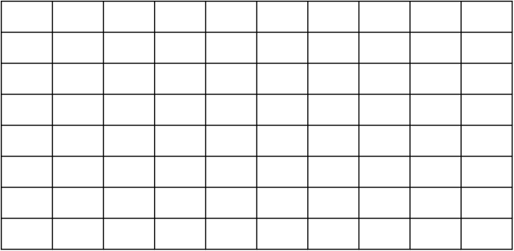

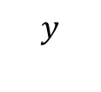
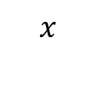
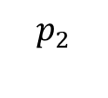
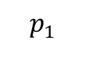
Assignment - 02
Question -02 : Draw the below line segment on computer screen using DDA & Bresenham line drawing algorithms
Compute the FLOPS (Floating-point operations per second)
$$y$$
$$p_{2}$$
$$p_{1}$$
$$x$$
$$x$$
Fig. (a): Line segment with end points $p_{1}=(8.8,0.8)$ and $p_{2}=(1,3.4)$

Slide 5
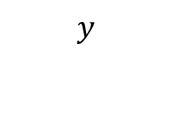



Assignment - 03
Question -03 : Draw the below line segment on computer screen using DDA & Bresenham line drawing algorithms
Compute the FLOPS (Floating-point operations per second)
$$y$$
$$p_{2}$$
$$p_{1}$$
$$x$$
Fig. (b) Line segment with end points $p_{1}=(2.8,1.1)$ and $p_{2}=(9.2,4.9)$

Slide 6

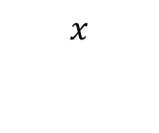
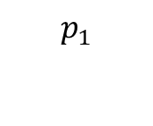

Assignment - 04
Question -04 : Draw the below line segment on computer screen using DDA & Bresenham line drawing algorithms
Compute the FLOPS (Floating-point operations per second)
$$y$$
$$p_{2}$$
$$p_{1}$$
$$x$$
Fig. (a) Line segment with end points $p_{1}=(3.4,1.1)$ and $p_{2}=(6.9,7)$

Slide 7













Assignment - 05
Question -05 : Draw the following graphics by using DDA & Bresenham line drawing algorithms.
$$y$$
$$p_{1}$$
Where,
$$p_{1}=(7.5, 9.2)$$
$$p_{2}$$
$$p_{5}$$
$$p_{2}=(4.4, 5.4)$$
$$p_{3}=(4.4, 0.4)$$
$$p_{4}=(10.4, 0.4)$$
$$p_{4}=(10.4, 5.4)$$
$$p_{3}$$
$$p_{4}$$
$$x$$
$$(0,0)$$

Slide 8





Assignment - 06
Question -06 : Draw the following graphics by using DDA & Bresenham line drawing algorithms.
$$y$$
$$p_{1}$$
Where,
$$p_{1}=(7.5, 9.2)$$
$$p_{2}=(4.4, 5.4)$$
$$p_{3}=(4.4, 0.4)$$
$$p_{2}$$
$$p_{5}$$
$$p_{4}=(10.4, 0.4)$$
$$p_{4}=(10.4, 5.4)$$
$$p_{3}$$
$$p_{4}$$
$$x$$
$$(0,0)$$

Slide 9


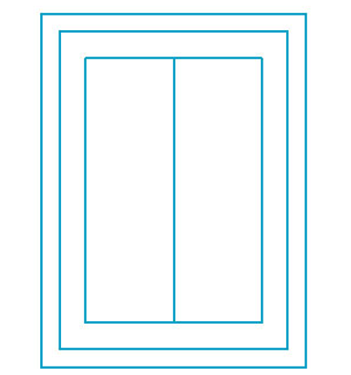
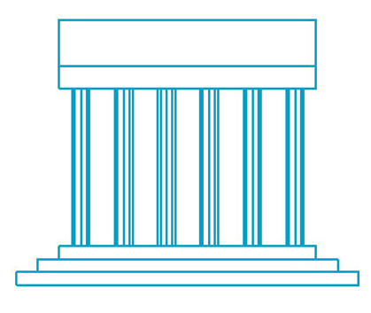
Assignment - 07
Question -07 : Draw the following graphics by using DDA & Bresenham line drawing algorithms.
Note*: Consider the coordinates of each line segment by your choice
(a)
(b)
(c)
(d)

Slide 10
Thank you !

